Slide 1


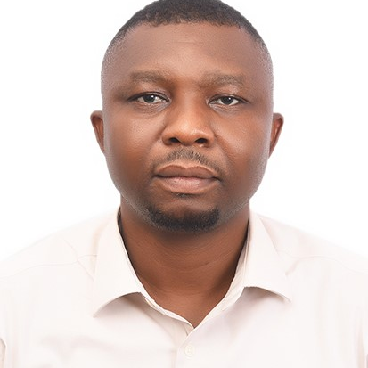
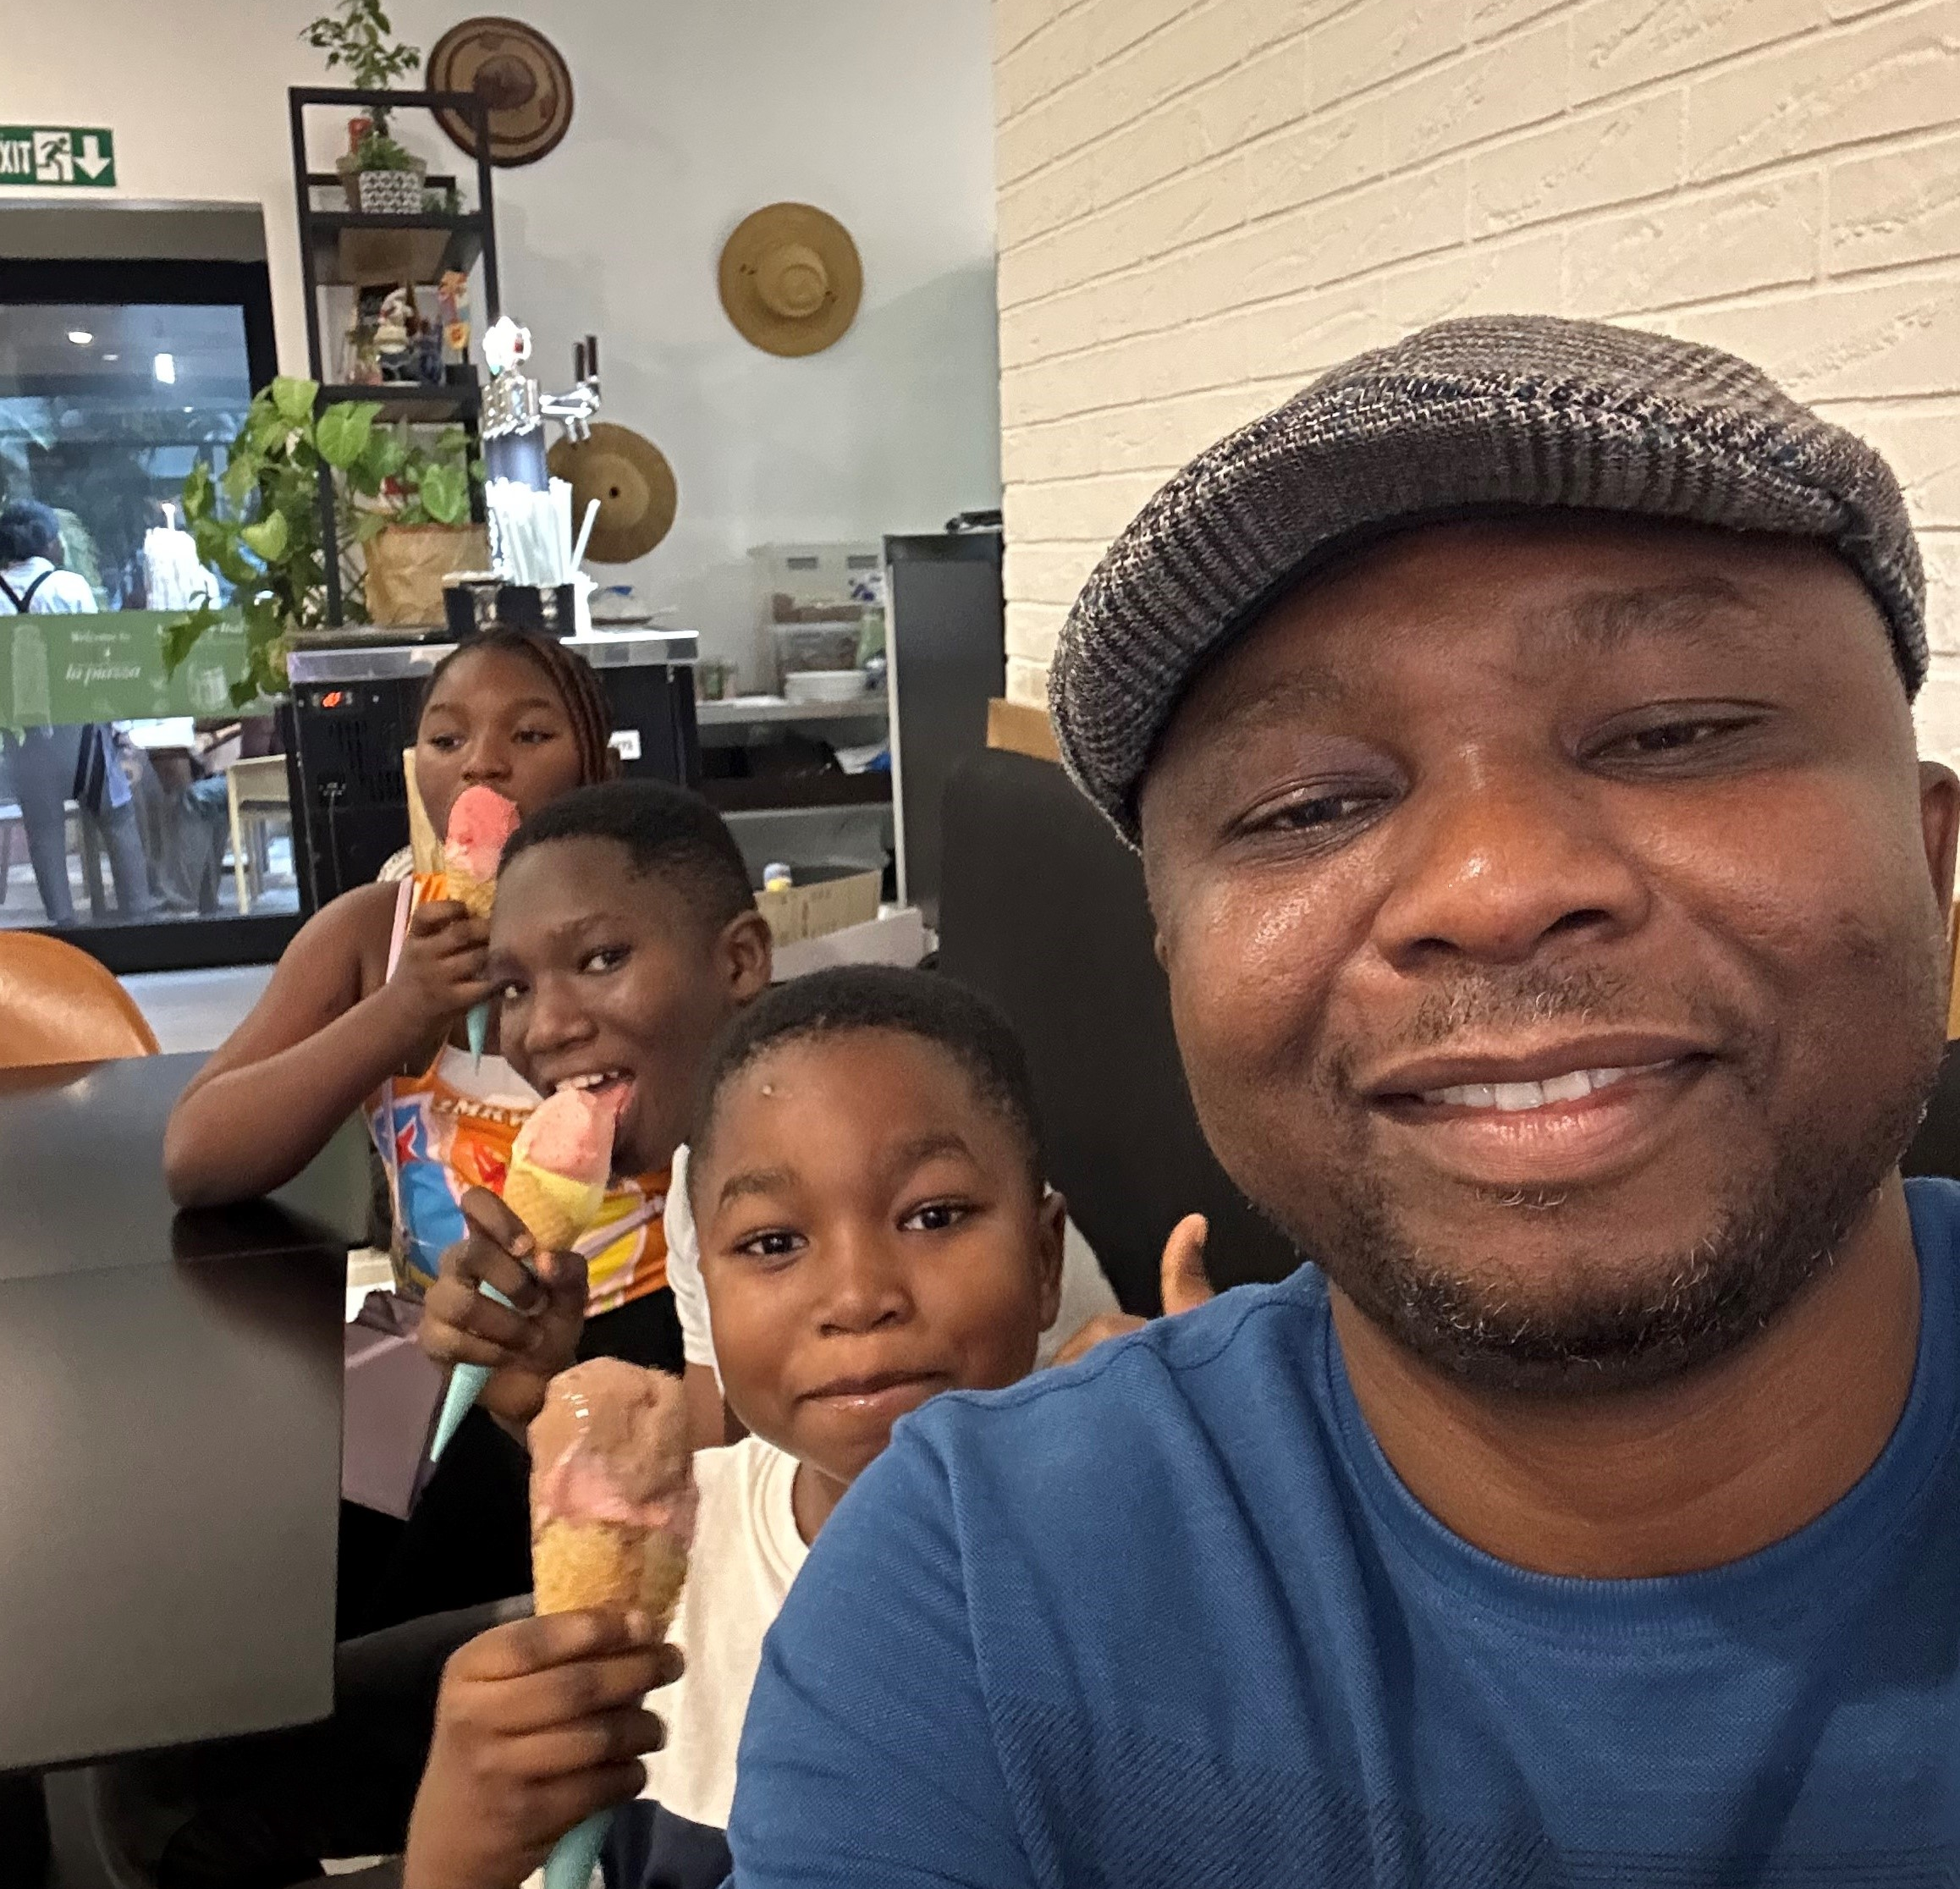
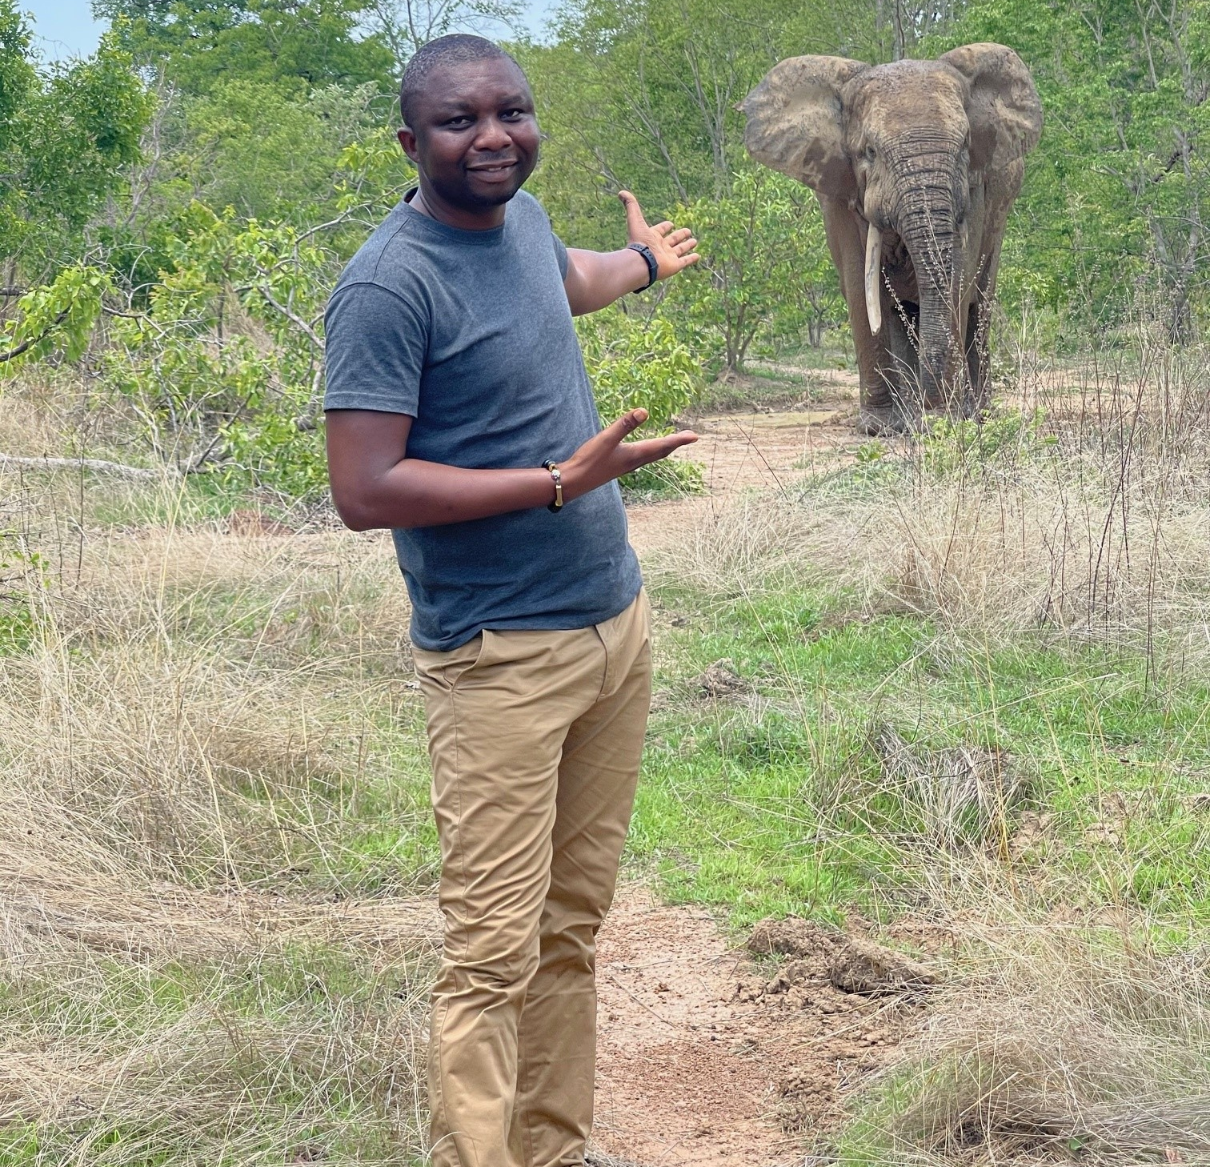
Getting to Know Me
Work
Personal
My role
Branch Manager, Cashew
Significant others / family members / furry friends in my life
Wife: Charity, Kids: Miguel, Janelle, Kacy
Brother: Alirah, Friend: Ing Wahab
Tenure in ofi/Olam
9 years
How I enjoy spending my free time
Tourism, Outing with kids and Movies
Previous companies I have worked at
TechnoServe/ACi, World Vision Gh, Red River Foods
My favorite / comfort food
Tou Zaafi with Neri soup
Why I joined ofi/Olam and what keeps me here?
Passion for cashew and working with farmers
Ofi is transformational and Rewarding
My favorite song
Bob Marley – Bad Card
Rowell Weyori
Papa Row
A few fun facts about me
“Putting smiles on the faces of others”
This is me outside work, doing stuff I enjoy in my life …

